Slide 1
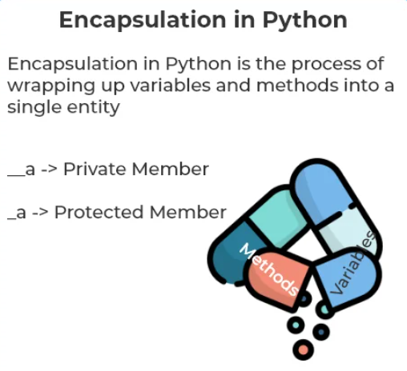
Encapsulation
Encapsulation in Python is the process of wrapping up variables and methods into a single entity.

